Slide 1
Module II
Data Exploration and Data Preprocessing

Slide 2
Module II: Topics
Types of Attributes
Statistical Description
Data Similarity and dissimilarity
Why preprocessing?
Data cleaning , Data Integration
02/10/21
Data Mining: Concepts and Techniques

Slide 3
Module II: Topics
Data Reduction :
Attribute subset selection, Histograms, Clustering, Sampling, Data cube aggregation
Data transformation and Data Discretization :
Normalization, Binning, Histogram Analysis
Self Learning : Data Visualization, Concept heirarchy generation
02/10/21
Data Mining: Concepts and Techniques

Slide 4
Why Data Preprocessing?
Data in the real world is dirty
  incomplete: lacking attribute values, lacking certain attributes of interest, or containing only aggregate data
    e.g., occupation=“ ”
  noisy: containing errors or outliers
    e.g., Salary=“-10”
  inconsistent: containing discrepancies in codes or names
    e.g., Age=“42” Birthday=“03/07/1997”
    e.g., Was rating “1,2,3”, now rating “A, B, C”
    e.g., discrepancy between duplicate records
02/10/21
Data Mining: Concepts and Techniques

Slide 5
Why Is Data Dirty?
Incomplete data may come from
  “Not applicable” data value when collected
  Different considerations between the time when the data was collected and when it is analyzed.
  Human/hardware/software problems
Noisy data (incorrect values) may come from
  Faulty data collection instruments
  Human or computer error at data entry
  Errors in data transmission
Inconsistent data may come from
  Different data sources
  Functional dependency violation (e.g., modify some linked data)
Duplicate records also need data cleaning
02/10/21
Data Mining: Concepts and Techniques

Slide 6
Why Is Data Preprocessing Important?
No quality data, no quality mining results!
  Quality decisions must be based on quality data
    e.g., duplicate or missing data may cause incorrect or even misleading statistics.
  Data warehouse needs consistent integration of quality data
Data extraction, cleaning, and transformation comprises the majority of the work of building a data warehouse
02/10/21
Data Mining: Concepts and Techniques

Slide 7
Multi-Dimensional Measure of Data Quality
A well-accepted multidimensional view:
  Accuracy
  Completeness
  Consistency
  Timeliness
  Believability
  Value added
  Interpretability
  Accessibility
Broad categories:
  Intrinsic, contextual, representational, and accessibility
02/10/21
Data Mining: Concepts and Techniques

Slide 8
Data Exploration /
Descriptive Data Summarization
02/10/21
Data Mining: Concepts and Techniques

Slide 9
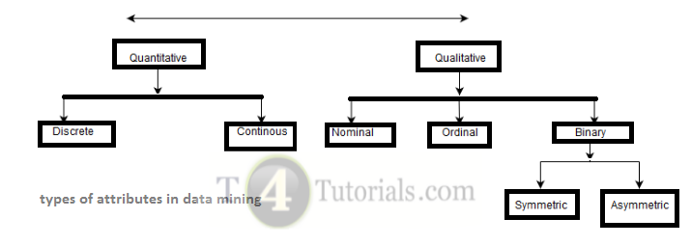
Attribute Types

Slide 10
Attribute Types
Attribute (features, variables): a data field, representing a characteristic or feature of a data object.
■ E.g., customer _ID, name, address of a customer
■ Attribute Types:
■ Numerical / Character
■ Numerical : discrete (integer) / continous (real no)
Binary : Symmetric / Asymmetric
 Numerical : Interval-scaled, ratio-scaled
■ Categorical : Nominal / Ordinal
■
02/10/21
Data Mining: Concepts and Techniques

Slide 11
Numeric Attribute
Numbers / Quantity (integer or real-valued)
Discrete Attribute
■ Has only a finite or countably infinite set of values , represented as integer variables
■ E.g., zip codes, or the set of words in a collection of documents
■ Note: Binary attributes are a special case of discrete attributes
Continuous Attribute
■ Has real numbers as attribute values
■ E.g., temperature, height, or weight
■ Practically, real values can only be measured and represented using a finite number of digits
02/10/21
Data Mining: Concepts and Techniques

Slide 12
Attribute Types
Binary
■ Nominal attribute with only 2 states (0 and 1)
■ Symmetric binary: both outcomes equally important
e.g., gender
■ Asymmetric binary: outcomes not equally important.
e.g., medical test (positive v/s negative)
■ Convention: assign 1 to most important outcome (e.g., HIV positive)

Slide 13
Data measurement scales
In statistics, there are four data measurement scales: nominal, ordinal, interval and ratio.
These are simply ways to sub-categorize different types of data
Note #1:

Slide 14
Attribute Types
Nominal: categories, “names of things”
■ Color = {black, red, green, blue, white}
marital status, occupation, ID numbers, zip codes
Ordinal
■ Values have a meaningful order (ranking) but magnitude between successive values is not known.
Size = {small, medium, large}
Grades = {First, Second, Third}
Army rankings = {General, Major, Lieutenant}
02/10/21
Data Mining: Concepts and Techniques

Slide 15
Nominal Attribute Types
Nominal scales are used for labeling variables, without any quantitative value.
- mutually exclusive (no overlap) and none of them have any numerical significance.
Note #1: a sub-type of nominal scale with only two categories (e.g. yes/no) is called “dichotomous”.
Note #2: Other sub-types of nominal data are “nominal with order” (like “cold, warm, hot, very hot”) and nominal without order (like “male/female/trans-gender”).

Slide 16
Data measurement scales
In statistics, there are four data measurement scales: nominal, ordinal, interval and ratio.
These are simply ways to sub-categorize different types of data
Note #1:

Slide 17
Ordinal Attribute Types
With ordinal scales, the order of the values is what’s important and significant, but the differences between each one is not really known.
Note #1: The best way to determine central tendency on a set of ordinal data is to use the mode or median

Slide 18
Interval scaled
Interval scales are numeric scales in which we know both the order and the exact differences between the values.
Example : temperature in celsius
Central tendency can be measured by mode, median, or mean; standard deviation can also be calculated.
With interval data, we can add and subtract, but cannot multiply or divide.
Note #1: they don’t have a “true zero.”

Slide 19
Ratio scaled
Ratio scales give us the ultimate–order, interval values, plus the ability to calculate ratios since a “true zero” can be defined.
– allows for a wide range of both descriptive and inferential statistics to be applied.
Example : height, weight, and duration.
Note #1: variables can be meaningfully added, subtracted, multiplied, divided (ratios).
Central tendency can be measured by mode, median, or mean; measures of dispersion, such as standard deviation and coefficient of variation can also be calculated from ratio scales.

Slide 20
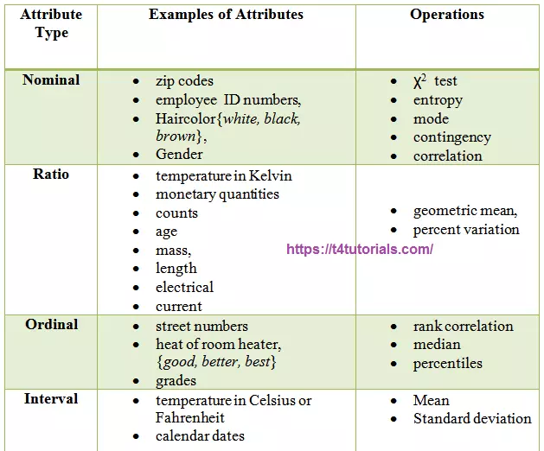

Slide 21
Mining Data Descriptive Characteristics
Motivation
  To better understand the data: central tendency and dispersion
Measures of central tendency
  Mean, median, mode and midrange
Measures of data dispersion
  Quartiles, interquartile range (IQR) and variance
From data mining point of view,
  Measures to be computed efficiently on large databases
  3 notions introduced : distributive measure, algebraic measure and holistic measure
02/10/21
Data Mining: Concepts and Techniques

Slide 22
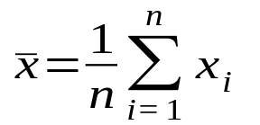
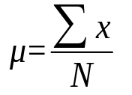
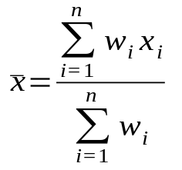
Measuring the Central Tendency
Mean (algebraic measure) : i.e.,
Weighted arithmetic mean:
  Trimmed mean: chopping extreme values
Distributive measure : computed for a given data set by partitioning into smaller subsets, computing measure for each subset and then merging them to arrive at measure for entire (original) data set.
  Sum(), count(), min(), max are distributive measures
  average of the middle two values otherwise
Algebraic measure : Applying an algebraic function to 2 or more distributive measures
  Average() is algebraic measure as it is sum()/count()
02/10/21
Data Mining: Concepts and Techniques

Slide 23
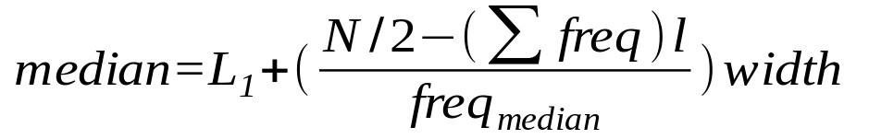
Measuring the Central Tendency
Median: A holistic measure(computed on entire dataset as a whole)
  Middle value if odd number of values, or average of the middle two values otherwise
  Holistic measures are much more expensive than distibutive
  Estimated by interpolation (for grouped data):
Mode
  Value that occurs most frequently in the data
  Unimodal, bimodal, trimodal ; 2 or more modes - multimodal
  Empirical formula for unimodal,moderately skewed data:
02/10/21
Data Mining: Concepts and Techniques

Slide 24
Grouped data
Estimated mean and estimated median of grouped d
ata

Slide 25
Symmetric vs. Skewed Data
Symmetric distribution - left and right hand sides of the distribution are roughly equally balanced around the mean (mirror-images of one another).
Skewed distributions (non-symmetric) - commonly have one tail of the distribution considerably longer or drawn out relative to the other tail. In "skewed right" distribution, the tail is on the right side. In "skewed left" distribution, the tail is on the left side.
Midrange, an algebraic measure, is average of largest and smallest value can also be used to assess central tendency.

Slide 26



Symmetric vs. Skewed Data
Median, mean and mode of symmetric, positively and negatively skewed data
02/10/21
Data Mining: Concepts and Techniques

Slide 27
Measuring the Dispersion of Data
Dispersion or variance :
degree to which numerical data tend to spread
Measures of data dispersion
  Range, five-number summary (based on Quartiles), interquartile range (IQR) and std. deviation
  Box plots, a popular way of visualizing a distribution, plotted based on five-number summary and are a useful tool for identifying outliers
Let x₁, x₂, …., x_{n} be a set of observations for some attribute and assume that the data are sorted in increasing numerical order.
Range : difference between largest (max()) and smallest (min()) values
02/10/21
Data Mining: Concepts and Techniques

Slide 28
Measuring the Dispersion of Data
Quartiles: provide information of center, spread and shape of a distribution
  First quartile, Q₁ (25th percentile), third quartile, Q₃ (75th percentile)
  Median is 50th percentile
  Inter-quartile range: (IQR = Q₃ – Q₁) ,is a measure of spread that gives the range covered by the middle half of the data
  Q₁ , Q₃ and IQR are holistic measures
  Outlier – a value higher or lower than 1.5 x IQR
Five number summary: (min, Q₁, M, Q₃, max)
  Provides full summary of the shape of a distribution
02/10/21
Data Mining: Concepts and Techniques

Slide 29
Example
Is the following data set symmetric, right skewed
or left skewed ? Give reason.
27 ; 28 ; 30 ; 32 ; 34 ; 38 ; 41 ; 42 ; 43 ; 44 ;46 ; 53 ; 56 ; 62
n=14
02/10/21
Data Mining: Concepts and Techniques

Slide 30
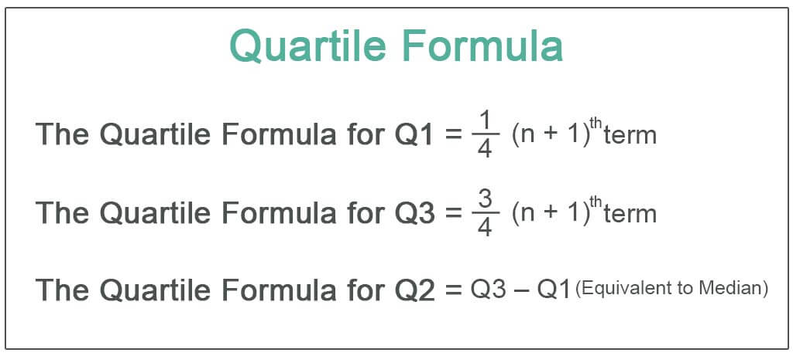
Example
The statistics of the data set are
mean: 41.1; median: 41.5;
Q1: first quartile = 32
Q3: third quartile = 46
02/10/21
Data Mining: Concepts and Techniques

Slide 31
Example
The statistics of the data set are
mean: 41.1; median: 41.5;
first quartile: 32; third quartile: 46.
We can conclude that the data set is skewed left / negatively for two reasons :
● The mean is less than the median. There is only a very small difference between the mean and median, so this is not a very strong reason.
● A better reason is that the median is closer to the 3rd quartile than the 1st quartile.
02/10/21
Data Mining: Concepts and Techniques

Slide 32
Measuring the Dispersion of Data
Boxplot : a popular way of visualizing a distribution,
ends of the box are the quartiles Q₃ and Q₁ , so box length is the interquartile range (IQR)
median is marked by a line within the box
whiskers are marked outside the box (min and max) extend to
- smallest and largest observations only if they are less than 1.5*IQR
- or at the most extreme observations occurring within 1.5*IQR
outlier to be plot individually
  Outlier: usually, a value higher/lower than 1.5 x IQR
  Efficient computation of boxplots or even approximate boxplots remains challenging issue for the mining of large data sets
02/10/21
Data Mining: Concepts and Techniques

Slide 33
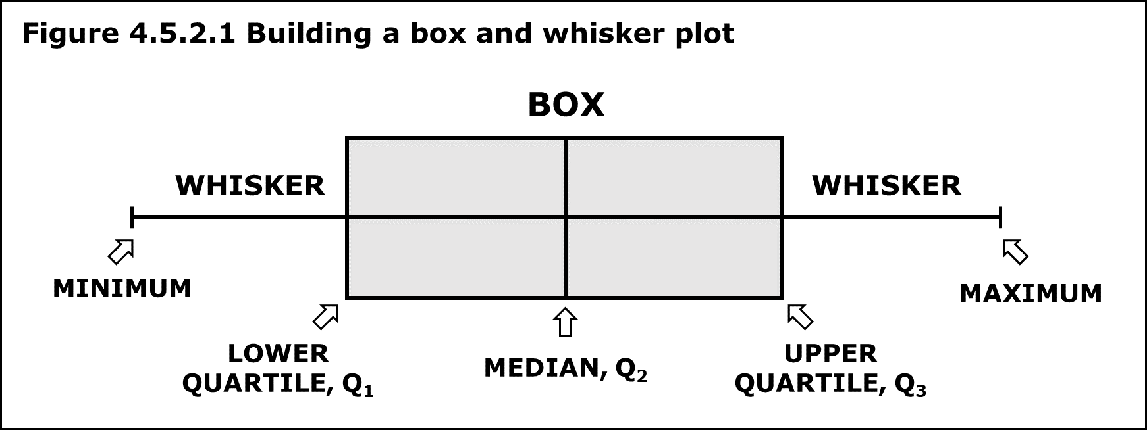
Box Plot Example
Find the maximum, minimum, median, first quartile, third quartile for the given data set: 23, 42, 12, 10, 15, 14, 9.
Solution: Arrange the given dataset in ascending order.
9, 10, 12, 14, 15, 23, 42
Hence, Minimum = 9 Maximum = 42 Median = 14
First Quartile = 10 (Middle value of 9, 10, 12 is 10) Third Quartile = 23 (Middle value of 15, 23, 42 is 23).

Slide 34
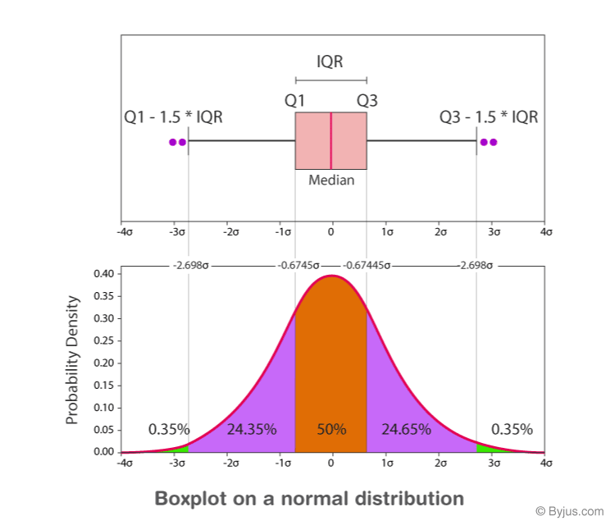

Slide 35
Applications of Box Plot
It is used to know:
The outliers and their values
Symmetry of Data
Tight grouping of data
Data skewness - if, in which direction and how

Slide 36

Boxplot Analysis
Five-number summary of a distribution:
Minimum, Q1, M, Q3, Maximum
Boxplot
  Data is represented with a box
  The ends of the box are at the first and third quartiles, i.e., the height of the box is IRQ
  The median is marked by a line within the box
Whiskers: two lines outside the box extend to
- smallest and largest observations only if they are less than 1.5*IQR
- or at the most extreme observations occurring within 1.5*IQR
02/10/21
Data Mining: Concepts and Techniques

Slide 37

Visualization of Data Dispersion: Boxplot Analysis
02/10/21
Data Mining: Concepts and Techniques

Slide 38
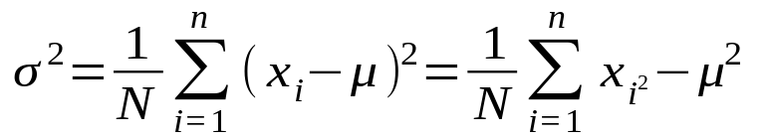
Measuring the Dispersion of Data
Variance and standard deviation (algebraic measure)
  Variance:
  Standard deviation s (or σ) is the square root of variance, measures spread about the mean (should be used only when mean is chosen as measure of center)
  σ = 0 only when there is no spread i.e., all observations have same value, otherwise σ > 0
02/10/21
Data Mining: Concepts and Techniques

Slide 39
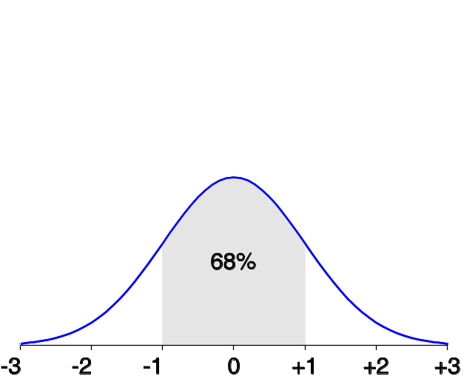
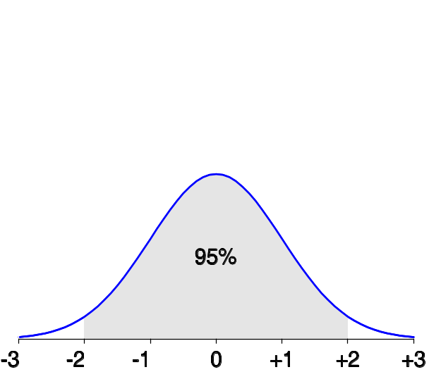
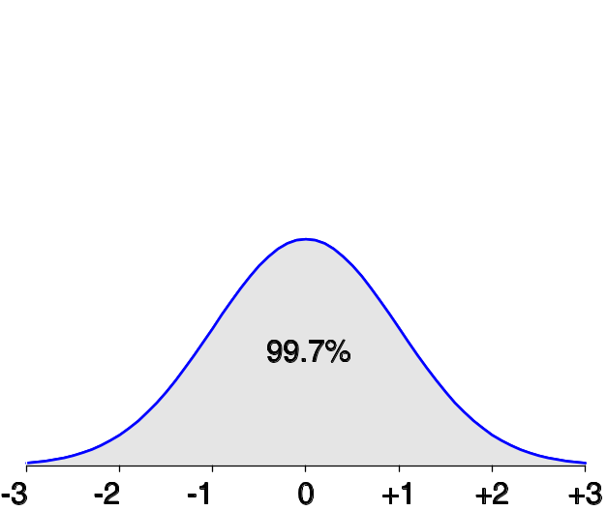
Properties of Normal Distribution Curve
The normal (distribution) curve
  From μ–σ to μ+σ: contains about 68% of the measurements (μ: mean, σ: standard deviation)
  From μ–2σ to μ+2σ: contains about 95% of it
  From μ–3σ to μ+3σ: contains about 99.7% of it
02/10/21
Data Mining: Concepts and Techniques

Slide 40
Example
Example 3: A marathon race was completed by 5 participants. What is the range of times given in hours below?
2.7 hr, 8.3 hr, 3.5 hr, 5.1 hr, 4.9 hr
Solution: Ordering the data from least to greatest, we get:
2.7, 3.5, 4.9, 5.1, 8.3
Range = highest - lowest = 8.3 hr - 2.7 hr = 5.6 hr
Answer: The range of swim times is 5.6 hr.
02/10/21
Data Mining: Concepts and Techniques

Slide 41
Example
Find the number in the following set of data where 20 percent of values fall below it, and 80 percent fall above:
1 3 5 6 9 11 12 13 19 21 22 32 35 36 45 44 55 68 79 80 81 88 90 91 92 100 112 113 114 120 121 132 145 146 149 150 155 180 189 190
02/10/21
Data Mining: Concepts and Techniques

Slide 42
Answer
Step 1: Order the data from smallest to largest. The data in the question is already in ascending order.
Step 2: Count how many observations you have in your data set. this particular data set has 40 items.
Step 3: Convert any percentage to a decimal for “q”. We are looking for the number where 20 percent of the values fall below it, so convert that to .2.
Step 4: Insert your values into the formula:
ith observation = q (n + 1)
ith observation = .2 (40 + 1) = 8.2
Answer: The ith observation is at 8.2, so we round down to 8 (remembering that this formula is an estimate). The 8th number in the set is 13.
02/10/21
Data Mining: Concepts and Techniques

Slide 43

Histogram Analysis
Graph displays of basic statistical class descriptions
  Frequency histograms
    A univariate graphical method
    Consists of a set of rectangles that reflect the counts or frequencies of the classes present in the given data
02/10/21
Data Mining: Concepts and Techniques

Slide 44
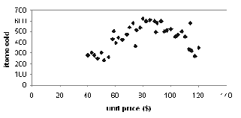
Scatter plot
Provides a first look at bivariate data to see clusters of points, outliers, etc
Each pair of values is treated as a pair of coordinates and plotted as points in the plane
02/10/21
Data Mining: Concepts and Techniques

Slide 45
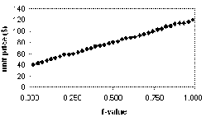
Quantile Plot
Displays all of the data (allowing the user to assess both the overall behavior and unusual occurrences)
Plots quantile information
  For a data x_{i} , data sorted in increasing order, f_{i} indicates that approximately 100 f_{i}% of the data are below or equal to the value x_{i}
02/10/21
Data Mining: Concepts and Techniques

Slide 46
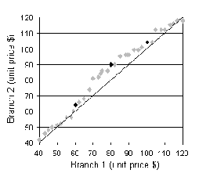
Quantile-Quantile (Q-Q) Plot
Graphs the quantiles of one univariate distribution against the corresponding quantiles of another
Allows the user to view whether there is a shift in going from one distribution to another
02/10/21
Data Mining: Concepts and Techniques

Slide 47
Scatter plot
Provides a first look at bivariate data to see clusters of points, outliers, etc
Each pair of values is treated as a pair of coordinates and plotted as points in the plane
02/10/21
Data Mining: Concepts and Techniques

Slide 48
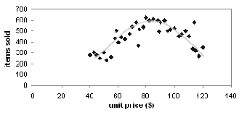
Loess Curve
Adds a smooth curve to a scatter plot in order to provide better perception of the pattern of dependence
Loess curve is fitted by setting two parameters: a smoothing parameter, and the degree of the polynomials that are fitted by the regression
02/10/21
Data Mining: Concepts and Techniques

Slide 49


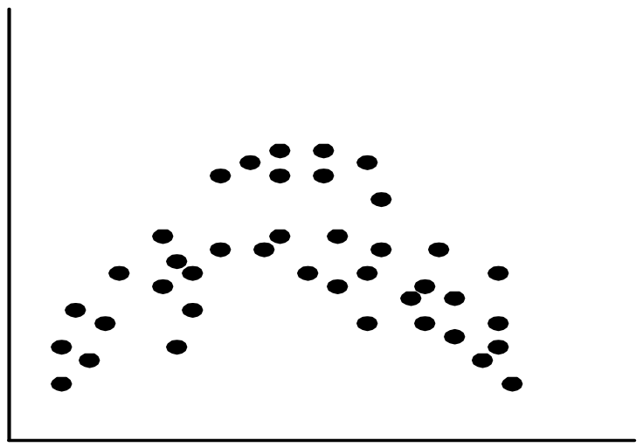
Positively and Negatively Correlated Data
02/10/21
Data Mining: Concepts and Techniques

Slide 50


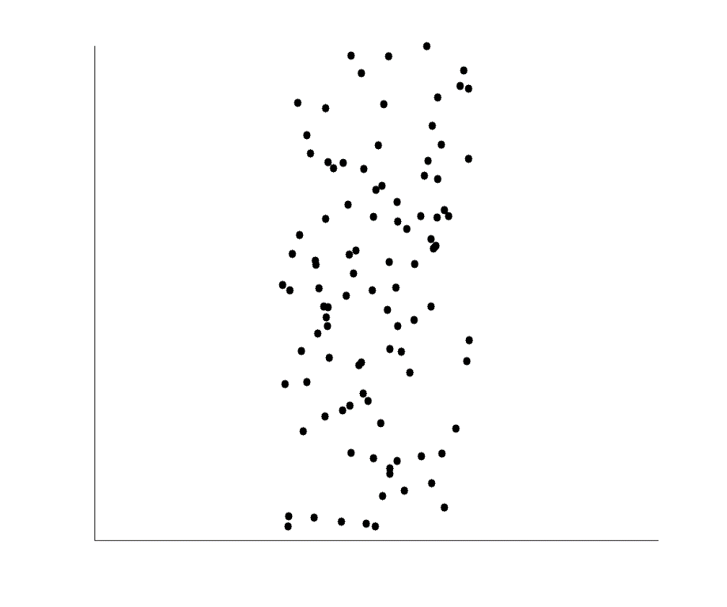
Not Correlated Data
02/10/21
Data Mining: Concepts and Techniques

Slide 51
Graphic Displays of Basic Statistical Descriptions
Histogram: (shown before)
Boxplot: (covered before)
Quantile plot: each value x_{i} is paired with f_{i} indicating that approximately 100 f_{i} % of data are ≤ x_{i}
Quantile-quantile (q-q) plot: graphs the quantiles of one univariant distribution against the corresponding quantiles of another
Scatter plot: each pair of values is a pair of coordinates and plotted as points in the plane
Loess (local regression) curve: add a smooth curve to a scatter plot to provide better perception of the pattern of dependence
02/10/21
Data Mining: Concepts and Techniques

Slide 52
Major Tasks in Data Preprocessing
Data cleaning
  Fill in missing values, smooth noisy data, identify or remove outliers, and resolve inconsistencies
Data integration
  Integration of multiple databases, data cubes, or files
Data transformation
  Normalization and aggregation
Data reduction
  Obtains reduced representation in volume but produces the same or similar analytical results
Data discretization
  Part of data reduction but with particular importance, especially for numerical data
02/10/21
Data Mining: Concepts and Techniques

Slide 53

Forms of Data Preprocessing
02/10/21
Data Mining: Concepts and Techniques

Slide 54
Data Preprocessing
Why preprocess the data?
Descriptive data summarization
Data cleaning
Data integration and transformation
Data reduction
Discretization and concept hierarchy generation
Summary
02/10/21
Data Mining: Concepts and Techniques

Slide 55
Data Cleaning
Importance
  “Data cleaning is one of the three biggest problems in data warehousing”—Ralph Kimball
  “Data cleaning is the number one problem in data warehousing”—DCI survey
Data cleaning tasks
  Fill in missing values
  Identify outliers and smooth out noisy data
  Correct inconsistent data
  Resolve redundancy caused by data integration
02/10/21
Data Mining: Concepts and Techniques

Slide 56
Missing Data
Data is not always available
  E.g., many tuples have no recorded value for several attributes, such as customer income in sales data
Missing data may be due to
  equipment malfunction
  inconsistent with other recorded data and thus deleted
  data not entered due to misunderstanding
  certain data may not be considered important at the time of entry
  not register history or changes of the data
Missing data may need to be inferred.
02/10/21
Data Mining: Concepts and Techniques

Slide 57
How to Handle Missing Data?
Ignore the tuple: usually done when class label is missing (assuming the tasks in classification—not effective when the percentage of missing values per attribute varies considerably.
Fill in the missing value manually: tedious + infeasible?
Fill in it automatically with
  a global constant : e.g., “unknown”, a new class?!
  the attribute mean
  the attribute mean for all samples belonging to the same class: smarter
  the most probable value: inference-based such as Bayesian formula or decision tree
02/10/21
Data Mining: Concepts and Techniques

Slide 58
Noisy Data
Noise: random error or variance in a measured variable
Incorrect attribute values may due to
  faulty data collection instruments
  data entry problems
  data transmission problems
  technology limitation
  inconsistency in naming convention
Other data problems which requires data cleaning
  duplicate records
  incomplete data
  inconsistent data
02/10/21
Data Mining: Concepts and Techniques

Slide 59
How to Handle Noisy Data?
Binning
  first sort data and partition into (equal-frequency) bins
  then one can smooth by bin means, smooth by bin median, smooth by bin boundaries, etc.
Regression
  smooth by fitting the data into regression functions
Clustering
  detect and remove outliers
Combined computer and human inspection
  detect suspicious values and check by human (e.g., deal with possible outliers)
02/10/21
Data Mining: Concepts and Techniques

Slide 60
Simple Discretization Methods: Binning
Equal-width (distance) partitioning
  Divides the range into N intervals of equal size: uniform grid
  if A and B are the lowest and highest values of the attribute, the width of intervals will be: W = (B–A)/N.
  Most straightforward, but outliers may dominate presentation
  Skewed data is not handled well
Equal-depth (frequency) partitioning
  Divides the range into N intervals, each containing approximately same number of samples
  Good data scaling
  Managing categorical attributes can be tricky
02/10/21

Slide 61
Binning Methods for Data Smoothing
Sorted data for price (in dollars): 4, 8, 9, 15, 21, 21, 24, 25, 26, 28, 29, 34
* Partition into equal-frequency (equi-depth) bins:
- Bin 1: 4, 8, 9, 15
- Bin 2: 21, 21, 24, 25
- Bin 3: 26, 28, 29, 34
* Smoothing by bin means:
- Bin 1: 9, 9, 9, 9
- Bin 2: 23, 23, 23, 23
- Bin 3: 29, 29, 29, 29
* Smoothing by bin boundaries:
- Bin 1: 4, 4, 4, 15
- Bin 2: 21, 21, 25, 25
- Bin 3: 26, 26, 26, 34
02/10/21
Data Mining: Concepts and Techniques

Slide 62
Regression
y
Y1
Y1’
y = x + 1
X1
x
02/10/21
Data Mining: Concepts and Techniques

Slide 63
Cluster Analysis
02/10/21
Data Mining: Concepts and Techniques

Slide 64
Data Cleaning as a Process
Data discrepancy detection
  Use metadata (e.g., domain, range, dependency, distribution)
  Check field overloading
  Check uniqueness rule, consecutive rule and null rule
  Use commercial tools
    Data scrubbing: use simple domain knowledge (e.g., postal code, spell-check) to detect errors and make corrections
    Data auditing: by analyzing data to discover rules and relationship to detect violators (e.g., correlation and clustering to find outliers)
Data migration and integration
  Data migration tools: allow transformations to be specified
  ETL (Extraction/Transformation/Loading) tools: allow users to specify transformations through a graphical user interface
Integration of the two processes
  Iterative and interactive (e.g., Potter’s Wheels data cleaning tool)
02/10/21

Slide 65
Chapter 3: Data Preprocessing
Why preprocess the data?
Data cleaning
Data integration and transformation
Data reduction
Discretization and concept hierarchy generation
Summary
02/10/21
Data Mining: Concepts and Techniques

Slide 66
Data Integration
Data integration:
  Combines data from multiple sources into a coherent store
Schema integration: e.g., A.cust-id ≡ B.cust-#
  Integrate metadata from different sources
Entity identification problem:
  Identify real world entities from multiple data sources, e.g., Bill Clinton = William Clinton
Detecting and resolving data value conflicts
  For the same real world entity, attribute values from different sources are different
  Possible reasons: different representations, different scales, e.g., metric vs. British units
02/10/21
Data Mining: Concepts and Techniques

Slide 67
Handling Redundancy in Data Integration
Redundant data occur often when integration of multiple databases
  Object identification: The same attribute or object may have different names in different databases
  Derivable data: One attribute may be a “derived” attribute in another table, e.g., annual revenue
Redundant attributes may be able to be detected by correlation analysis
Careful integration of the data from multiple sources may help reduce/avoid redundancies and inconsistencies and improve mining speed and quality
02/10/21
Data Mining: Concepts and Techniques

Slide 68
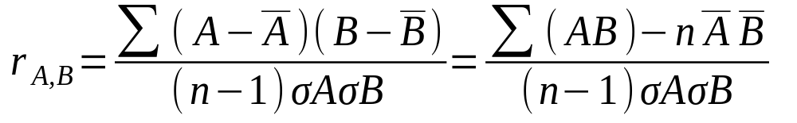


Correlation Analysis (Numerical Data)
Correlation coefficient (also called Pearson’s product moment coefficient)
where n is the number of tuples, and are the respective means of A and B, σ_{A} and σ_{B} are the respective standard deviation of A and B, and Σ(AB) is the sum of the AB cross-product.
If r_{A,B} > 0, A and B are positively correlated (A’s values increase as B’s). The higher, the stronger correlation.
r_{A,B} = 0: independent; r_{A,B} < 0: negatively correlated

Slide 69
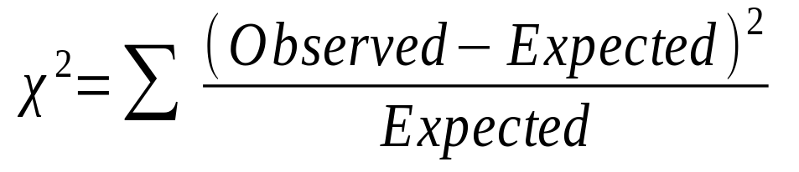
Correlation Analysis (Categorical Data)
Χ² (chi-square) test
The larger the Χ² value, the more likely the variables are related
The cells that contribute the most to the Χ² value are those whose actual count is very different from the expected count
Correlation does not imply causality
  # of hospitals and # of car-theft in a city are correlated
  Both are causally linked to the third variable: population
02/10/21
Data Mining: Concepts and Techniques

Slide 70
Chi-Square Calculation: An Example
 | Play chess | Not play chess | Sum (row)
Like science fiction | 250(90) | 200(360) | 450
Not like science fiction | 50(210) | 1000(840) | 1050
Sum(col.) | 300 | 1200 | 1500
02/10/21
Data Mining: Concepts and Techniques

Slide 71
 | Play chess | Not play chess | Sum (row)
Like science fiction | 250(90) | 200(360) | 450
Not like science fiction | 50(210) | 1000(840) | 1050
Sum(col.) | 300 | 1200 | 1500
Chi-Square Calculation: An Example
Χ² (chi-square) calculation (numbers in parenthesis are expected counts calculated based on the data distribution in the two categories)
It shows that like_science_fiction and play_chess are correlated in the group
02/10/21
Data Mining: Concepts and Techniques

Slide 72
Data Transformation
Smoothing: remove noise from data
Aggregation: summarization, data cube construction
Generalization: concept hierarchy climbing
Normalization: scaled to fall within a small, specified range, as [-1.0 to 1.0] or [0.0 to 1.0]
  min-max normalization
  z-score normalization
  normalization by decimal scaling
Attribute/feature construction
  New attributes constructed from the given ones
02/10/21
Data Mining: Concepts and Techniques

Slide 73
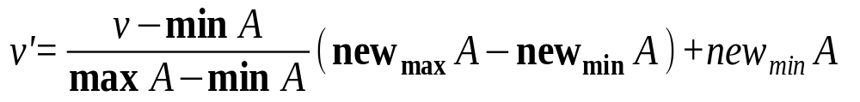
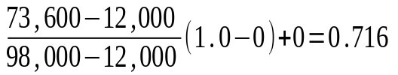
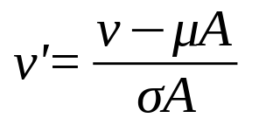
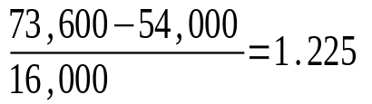
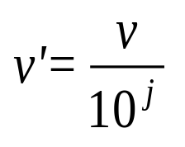
Data Transformation: Normalization
Min-max normalization: to [new_min_{A}, new_max_{A}]
  Ex. Let income range $12,000 to $98,000 normalized to [0.0, 1.0]. Then $73,000 is mapped to
Z-score normalization (μ: mean, σ: standard deviation):
  Ex. Let μ = 54,000, σ = 16,000. Then
Normalization by decimal scaling
Where j is the smallest integer such that Max(|ν’|) < 1
02/10/21
Data Mining: Concepts and Techniques

Slide 74
Chapter 3: Data Preprocessing
Why preprocess the data?
Data cleaning
Data integration and transformation
Data reduction
Discretization and concept hierarchy generation
Summary
02/10/21
Data Mining: Concepts and Techniques

Slide 75
Data Reduction Strategies
Why data reduction?
  A database/data warehouse may store terabytes of data
  Complex data analysis/mining may take a very long time to run on the complete data set
Data reduction
  Obtain a reduced representation of the data set that is much smaller in volume but yet produce the same (or almost the same) analytical results
Data reduction strategies
  Data cube aggregation
  Attribute subset selection — e.g., remove irrelevant, weakly relevant or reduntant attributes/dimensions
  Data Compression
  Numerosity reduction — e.g., fit data into models
  Discretization and concept hierarchy generation
02/10/21
Data Mining: Concepts and Techniques

Slide 76
Data Cube Aggregation
The lowest level of a data cube (base cuboid)
  The aggregated data for an individual entity of interest
  E.g., a customer in a phone calling data warehouse
Multiple levels of aggregation in data cubes
  Further reduce the size of data to deal with
Reference appropriate levels
  Use the smallest representation which is enough to solve the task
Queries regarding aggregated information should be answered using data cube, when possible
02/10/21
Data Mining: Concepts and Techniques

Slide 77
Attribute Subset Selection
Feature selection (i.e., attribute subset selection):
  Select a minimum set of features such that the probability distribution of different classes given the values for those features is as close as possible to the original distribution given the values of all features
  reduce # of patterns in the patterns, easier to understand
Heuristic methods (due to exponential # of choices):
  Step-wise forward selection
  Step-wise backward elimination
  Combining forward selection and backward elimination
  Decision-tree induction
02/10/21
Data Mining: Concepts and Techniques

Slide 78
Example of Decision Tree Induction
Initial attribute set:
{A1, A2, A3, A4, A5, A6}
A4 ?
A1?
A6?
Class 1
Class 2
Class 1
Class 2
>
Reduced attribute set: {A1, A4, A6}
02/10/21
Data Mining: Concepts and Techniques

Slide 79
Heuristic Feature Selection Methods
There are 2^{d} possible sub-features of d features
Several heuristic feature selection methods:
  Best single features under the feature independence assumption: choose by significance tests
  Best step-wise feature selection:
    The best single-feature is picked first
    Then next best feature condition to the first, ...
  Step-wise feature elimination:
    Repeatedly eliminate the worst feature
  Best combined feature selection and elimination
  Optimal branch and bound:
    Use feature elimination and backtracking
02/10/21
Data Mining: Concepts and Techniques

Slide 80
Data Compression
String compression
  There are extensive theories and well-tuned algorithms
  Typically lossless
  But only limited manipulation is possible without expansion
Audio/video compression
  Typically lossy compression, with progressive refinement
  Sometimes small fragments of signal can be reconstructed without reconstructing the whole
Time sequence is not audio
  Typically short and vary slowly with time
02/10/21
Data Mining: Concepts and Techniques

Slide 81
Data Compression
Original Data
Compressed
Data
lossless
Original Data
Approximated
lossy
02/10/21
Data Mining: Concepts and Techniques

Slide 82
Dimensionality Reduction:
Wavelet Transformation
Haar2
Daubechie4
Discrete wavelet transform (DWT): linear signal processing, multi-resolutional analysis
Compressed approximation: store only a small fraction of the strongest of the wavelet coefficients
Similar to discrete Fourier transform (DFT), but better lossy compression, localized in space
Method:
  Length, L, must be an integer power of 2 (padding with 0’s, when necessary)
  Each transform has 2 functions: smoothing, difference
  Applies to pairs of data, resulting in two set of data of length L/2
  Applies two functions recursively, until reaches the desired length
02/10/21
Data Mining: Concepts and Techniques

Slide 83

DWT for Image Compression
Image
Low Pass High Pass
Low Pass High Pass
Low Pass High Pass
02/10/21
Data Mining: Concepts and Techniques

Slide 84
Dimensionality Reduction: Principal Component Analysis (PCA)
Given N data vectors from n-dimensions, find k ≤ n orthogonal vectors (principal components) that can be best used to represent data
Steps
  Normalize input data: Each attribute falls within the same range
  Compute k orthonormal (unit) vectors, i.e., principal components
  Each input data (vector) is a linear combination of the k principal component vectors
  The principal components are sorted in order of decreasing “significance” or strength
  Since the components are sorted, the size of the data can be reduced by eliminating the weak components, i.e., those with low variance. (i.e., using the strongest principal components, it is possible to reconstruct a good approximation of the original data
Works for numeric data only
Used when the number of dimensions is large
02/10/21
Data Mining: Concepts and Techniques

Slide 85
Principal Component Analysis
X2
Y1
Y2
X1
02/10/21
Data Mining: Concepts and Techniques

Slide 86
Numerosity Reduction
Reduce data volume by choosing alternative, smaller forms of data representation
Parametric methods
  Assume the data fits some model, estimate model parameters, store only the parameters, and discard the data (except possible outliers)
  Example: Log-linear models—obtain value at a point in m-D space as the product on appropriate marginal subspaces
Non-parametric methods
  Do not assume models
  Major families: histograms, clustering, sampling
02/10/21
Data Mining: Concepts and Techniques

Slide 87
Data Reduction Method (1): Regression and Log-Linear Models
Linear regression: Data are modeled to fit a straight line
  Often uses the least-square method to fit the line
Multiple regression: allows a response variable Y to be modeled as a linear function of multidimensional feature vector
Log-linear model: approximates discrete multidimensional probability distributions
02/10/21
Data Mining: Concepts and Techniques

Slide 88
Regress Analysis and Log-Linear Models
Linear regression: Y = w X + b
  Two regression coefficients, w and b, specify the line and are to be estimated by using the data at hand
  Using the least squares criterion to the known values of Y1, Y2, …, X1, X2, ….
Multiple regression: Y = b0 + b1 X1 + b2 X2.
  Many nonlinear functions can be transformed into the above
Log-linear models:
  The multi-way table of joint probabilities is approximated by a product of lower-order tables
  Probability: p(a, b, c, d) = αab βacχad δbcd

Slide 89

Data Reduction Method (2): Histograms
Divide data into buckets and store average (sum) for each bucket
Partitioning rules:
  Equal-width: equal bucket range
  Equal-frequency (or equal-depth)
  V-optimal: with the least histogram variance (weighted sum of the original values that each bucket represents)
  MaxDiff: set bucket boundary between each pair for pairs have the β–1 largest differences
02/10/21
Data Mining: Concepts and Techniques

Slide 90
Data Reduction Method (3): Clustering
Partition data set into clusters based on similarity, and store cluster representation (e.g., centroid and diameter) only
Can be very effective if data is clustered but not if data is “smeared”
Can have hierarchical clustering and be stored in multi-dimensional index tree structures
There are many choices of clustering definitions and clustering algorithms
Cluster analysis will be studied in depth in Chapter 7
02/10/21
Data Mining: Concepts and Techniques

Slide 91
Data Reduction Method (4): Sampling
Sampling: obtaining a small sample s to represent the whole data set N
Allow a mining algorithm to run in complexity that is potentially sub-linear to the size of the data
Choose a representative subset of the data
  Simple random sampling may have very poor performance in the presence of skew
Develop adaptive sampling methods
  Stratified sampling:
    Approximate the percentage of each class (or subpopulation of interest) in the overall database
    Used in conjunction with skewed data
Note: Sampling may not reduce database I/Os (page at a time)
02/10/21
Data Mining: Concepts and Techniques

Slide 92
Sampling: with or without Replacement
SRSWOR
(simple random
sample without
replacement)
SRSWR
Raw Data
02/10/21
Data Mining: Concepts and Techniques

Slide 93
Sampling: Cluster or Stratified Sampling
Raw Data
Cluster/Stratified Sample
02/10/21
Data Mining: Concepts and Techniques

Slide 94
Chapter 3: Data Preprocessing
Why preprocess the data?
Data cleaning
Data integration and transformation
Data reduction
Discretization and concept hierarchy generation
Summary
02/10/21
Data Mining: Concepts and Techniques

Slide 95
Discretization
Three types of attributes:
  Nominal — values from an unordered set, e.g., color, profession
  Ordinal — values from an ordered set, e.g., military or academic rank
  Continuous — real numbers, e.g., integer or real numbers
Discretization:
  Divide the range of a continuous attribute into intervals
  Some classification algorithms only accept categorical attributes.
  Reduce data size by discretization
  Prepare for further analysis
02/10/21
Data Mining: Concepts and Techniques

Slide 96
Discretization and Concept Hierarchy
Discretization
  Reduce the number of values for a given continuous attribute by dividing the range of the attribute into intervals
  Interval labels can then be used to replace actual data values
  Supervised vs. unsupervised
  Split (top-down) vs. merge (bottom-up)
  Discretization can be performed recursively on an attribute
Concept hierarchy formation
  Recursively reduce the data by collecting and replacing low level concepts (such as numeric values for age) by higher level concepts (such as young, middle-aged, or senior)
02/10/21
Data Mining: Concepts and Techniques

Slide 97
Discretization and Concept Hierarchy Generation for Numeric Data
Typical methods: All the methods can be applied recursively
  Binning (covered above)
    Top-down split, unsupervised,
  Histogram analysis (covered above)
    Top-down split, unsupervised
  Clustering analysis (covered above)
    Either top-down split or bottom-up merge, unsupervised
  Entropy-based discretization: supervised, top-down split
  Interval merging by χ² Analysis: unsupervised, bottom-up merge
  Segmentation by natural partitioning: top-down split, unsupervised
02/10/21
Data Mining: Concepts and Techniques

Slide 98
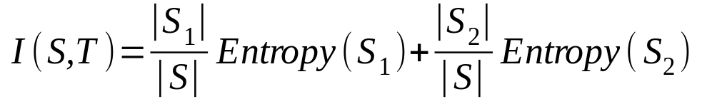
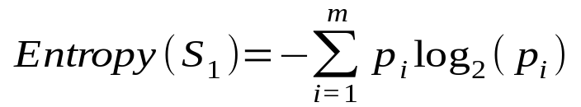
Entropy-Based Discretization
Given a set of samples S, if S is partitioned into two intervals S₁ and S₂ using boundary T, the information gain after partitioning is
Entropy is calculated based on class distribution of the samples in the set. Given m classes, the entropy of S₁ is
  where p_{i} is the probability of class i in S₁
The boundary that minimizes the entropy function over all possible boundaries is selected as a binary discretization
The process is recursively applied to partitions obtained until some stopping criterion is met
Such a boundary may reduce data size and improve classification accuracy
02/10/21
Data Mining: Concepts and Techniques

Slide 99
Interval Merge by χ² Analysis
Merging-based (bottom-up) vs. splitting-based methods
Merge: Find the best neighboring intervals and merge them to form larger intervals recursively
ChiMerge [Kerber AAAI 1992, See also Liu et al. DMKD 2002]
  Initially, each distinct value of a numerical attr. A is considered to be one interval
  χ² tests are performed for every pair of adjacent intervals
  Adjacent intervals with the least χ² values are merged together, since low χ² values for a pair indicate similar class distributions
  This merge process proceeds recursively until a predefined stopping criterion is met (such as significance level, max-interval, max inconsistency, etc.)
02/10/21
Data Mining: Concepts and Techniques

Slide 100
Segmentation by Natural Partitioning
A simply 3-4-5 rule can be used to segment numeric data into relatively uniform, “natural” intervals.
  If an interval covers 3, 6, 7 or 9 distinct values at the most significant digit, partition the range into 3 equi-width intervals
  If it covers 2, 4, or 8 distinct values at the most significant digit, partition the range into 4 intervals
  If it covers 1, 5, or 10 distinct values at the most significant digit, partition the range into 5 intervals
02/10/21
Data Mining: Concepts and Techniques

Slide 101
Example of 3-4-5 Rule
count
Step 1:
-$351 -$159 profit $1,838 $4,700
Min Low (i.e, 5%-tile) High(i.e, 95%-0 tile) Max
Step 2:
msd=1,000 Low=-$1,000 High=$2,000
Step 3:
(-$1,000 - $2,000)
(-$1,000 - 0)
(0 -$ 1,000)
($1,000 - $2,000)
Step 4:
(-$400 -$5,000)
(-$400 - 0)
(0 - $1,000)
($1,000 - $2, 000)
($2,000 - $5, 000)
(-$400 -
-$300)
(0 -
$200)
($1,000 -
$1,200)
($2,000 -
$3,000)
($200 -
$400)
($1,200 -
$1,400)
(-$300 -
-$200)
($3,000 -
$4,000)
($400 -
$600)
($1,400 -
$1,600)
(-$200 -
-$100)
($4,000 -
$5,000)
($600 -
$800)
($1,600 -
$1,800)
($1,800 -
$2,000)
(-$100 -
0)
($800 -
$1,000)
02/10/21
Data Mining: Concepts and Techniques

Slide 102
Concept Hierarchy Generation for Categorical Data
Specification of a partial/total ordering of attributes explicitly at the schema level by users or experts
  street < city < state < country
Specification of a hierarchy for a set of values by explicit data grouping
  {Urbana, Champaign, Chicago} < Illinois
Specification of only a partial set of attributes
  E.g., only street < city, not others
Automatic generation of hierarchies (or attribute levels) by the analysis of the number of distinct values
  E.g., for a set of attributes: {street, city, state, country}
02/10/21
Data Mining: Concepts and Techniques

Slide 103
Automatic Concept Hierarchy Generation
Some hierarchies can be automatically generated based on the analysis of the number of distinct values per attribute in the data set
  The attribute with the most distinct values is placed at the lowest level of the hierarchy
  Exceptions, e.g., weekday, month, quarter, year
country
15 distinct values
province_or_ state
365 distinct values
city
3567 distinct values
street
674,339 distinct values
02/10/21
Data Mining: Concepts and Techniques

Slide 104
Chapter 3: Data Preprocessing
Why preprocess the data?
Data cleaning
Data integration and transformation
Data reduction
Discretization and concept hierarchy generation
Summary
02/10/21
Data Mining: Concepts and Techniques

Slide 105
Summary
Data preparation or preprocessing is a big issue for both data warehousing and data mining
Discriptive data summarization is need for quality data preprocessing
Data preparation includes
  Data cleaning and data integration
  Data reduction and feature selection
  Discretization
A lot a methods have been developed but data preprocessing still an active area of research
02/10/21
Data Mining: Concepts and Techniques

Slide 106
References
D. P. Ballou and G. K. Tayi. Enhancing data quality in data warehouse environments. Communications of ACM, 42:73-78, 1999
T. Dasu and T. Johnson. Exploratory Data Mining and Data Cleaning. John Wiley & Sons, 2003
T. Dasu, T. Johnson, S. Muthukrishnan, V. Shkapenyuk. Mining Database Structure; Or, How to Build a Data Quality Browser. SIGMOD’02.
H.V. Jagadish et al., Special Issue on Data Reduction Techniques. Bulletin of the Technical Committee on Data Engineering, 20(4), December 1997
D. Pyle. Data Preparation for Data Mining. Morgan Kaufmann, 1999
E. Rahm and H. H. Do. Data Cleaning: Problems and Current Approaches. IEEE Bulletin of the Technical Committee on Data Engineering. Vol.23, No.4
V. Raman and J. Hellerstein. Potters Wheel: An Interactive Framework for Data Cleaning and Transformation, VLDB’2001

Slide 107
References
T. Redman. Data Quality: Management and Technology. Bantam Books, 1992
Y. Wand and R. Wang. Anchoring data quality dimensions ontological foundations. Communications of ACM, 39:86-95, 1996
R. Wang, V. Storey, and C. Firth. A framework for analysis of data quality research. IEEE Trans. Knowledge and Data Engineering, 7:623-640, 1995
https://www.mymarketresearchmethods.com/types-of-data-nominal-ordinal-interval-ratio/
https://www.itl.nist.gov/div898/handbook/eda/section3/histogr6.htm

Slide 108
References
T. Redman. Data Quality: Management and Technology. Bantam Books, 1992
Y. Wand and R. Wang. Anchoring data quality dimensions ontological foundations. Communications of ACM, 39:86-95, 1996
R. Wang, V. Storey, and C. Firth. A framework for analysis of data quality research. IEEE Trans. Knowledge and Data Engineering, 7:623-640, 1995
https://www.mymarketresearchmethods.com/types-of-data-nominal-ordinal-interval-ratio/
https://www.itl.nist.gov/div898/handbook/eda/section3/histogr6.htm

